Slide 1


Automated median gap detection system
For unstructured roads
Sub code: CS3811
Sub name: Project Work/Internship
Batch No. A29 Supervisor
Students Mr. Ashok M
Jayavarshini G (211721104061) Associate Professor
Harshini N (211721104053) Dept of Computer Science
and Engineering

Slide 2
ABSTRACT
Detecting median gaps is vital for Indian road safety and traffic management.
Lack of proper traffic signs in India makes this task more challenging.
Our project addresses the challenge of detecting median gaps without traffic signs.
We use advanced deep learning techniques for this purpose. Our motivation is to improve road safety and traffic efficiency in India.
Inadequate marking and signage of median gaps lead to accidents and congestion.

Slide 3
PROBLEM STATEMENT
The absence of proper traffic signs makes detecting median gaps on Indian roads challenging, leading to accidents and congestion.
This project uses deep learning (YOLO + DeepSORT) to automate median gap detection, improving road safety and traffic management.

Slide 4
OBJECTIVE
Implement the trained YOLO + DeepSORT model to process data and detect median gaps.
Apply object detection and tracking to identify and follow median gaps across frames in real-time.
Generate an annotated output showcasing detected median gaps with bounding boxes and labels.
Ensure accurate visualization of detection results by reducing false positives and improving model reliability.

Slide 5
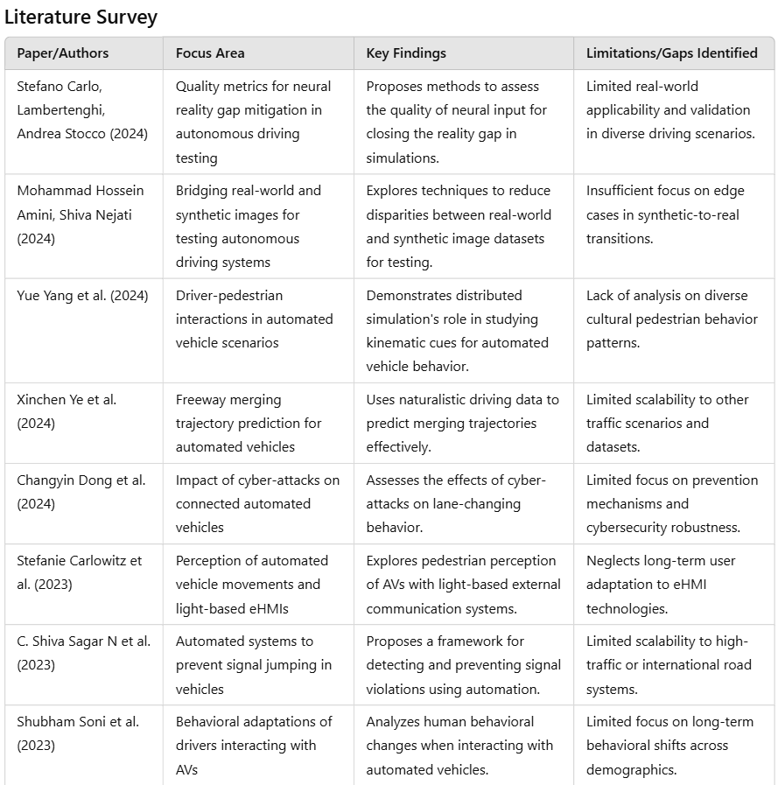

Slide 6
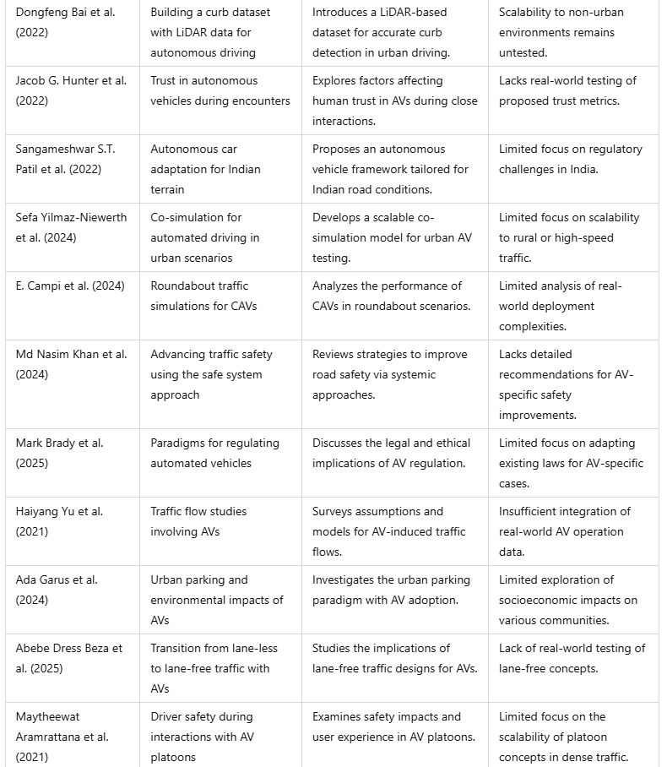

Slide 7
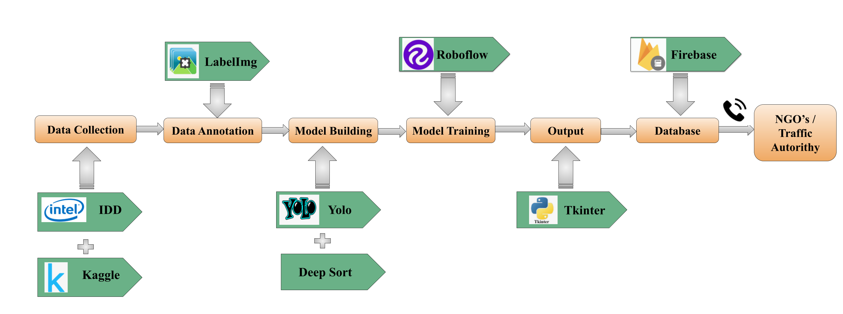
PROCESS FLOW DIAGRAM

Slide 8
ALGORITHMS
1. YOLO (You Only Look Once) - Object Detection
Function: Detects median gaps in road images/videos in real-time.Fast and efficient compared to traditional object detection models.Processes an entire image in a single pass, making it ideal for real-time applications.Uses bounding boxes to locate gaps in the median.
2. DeepSORT (Simple Online Tracker) - Object Tracking
Function: Tracks detected median gaps across video frames.Helps maintain object identity across multiple frames.

Slide 9
Uses motion information and appearance features to re-identify objects.Enhances real-time gap detection accuracy.
3.Roboflow - Model Training & Dataset Augmentation
Function: Optimizes dataset preparation and training for deep learning models.Streamlines annotation and dataset preprocessing.Enhances model accuracy through data augmentation.Provides cloud-based model training for improved performance.

Slide 10
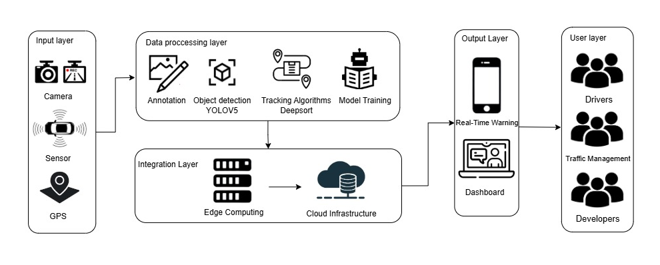
ARCHITECTURE DIAGRAM

Slide 11
MODULE DESCRIPTION
The proposed system follows a sequential procedure, beginning with data collection from IDD and Kaggle.
The collected data is then annotated using LabelImg, followed by model building using the YOLO and DeepSORT algorithms.
The model is then trained on Roboflow, and the output is displayed using the Tkinter Python library.

Slide 12
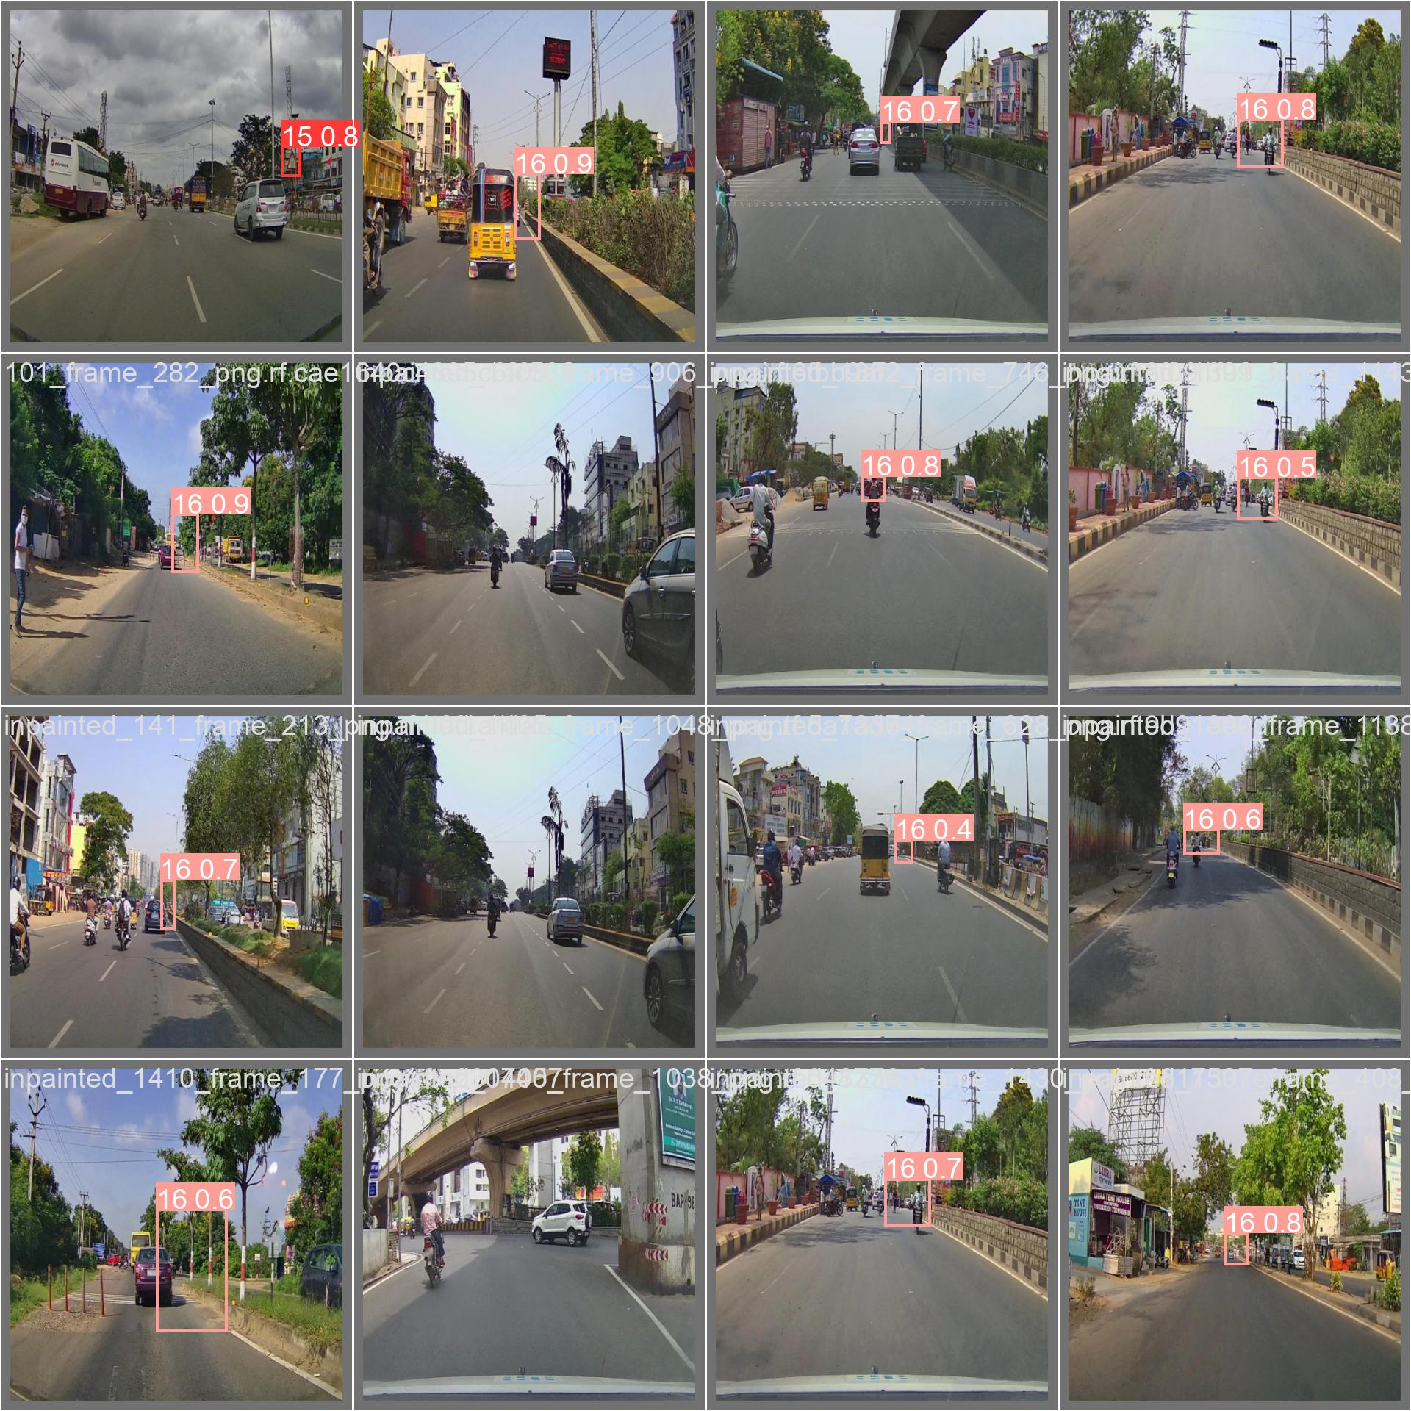
OUTPUT

Slide 13
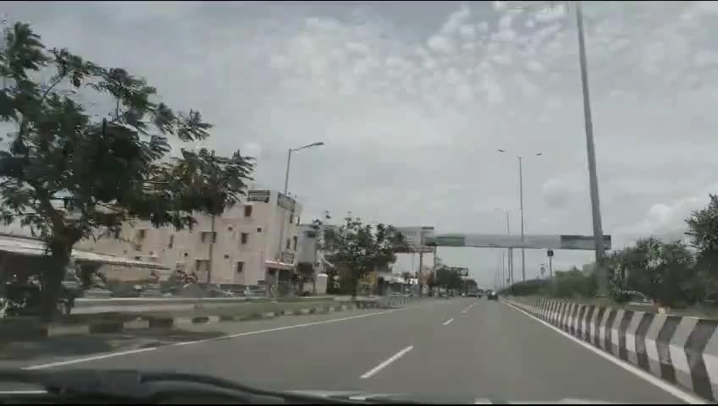

Slide 14
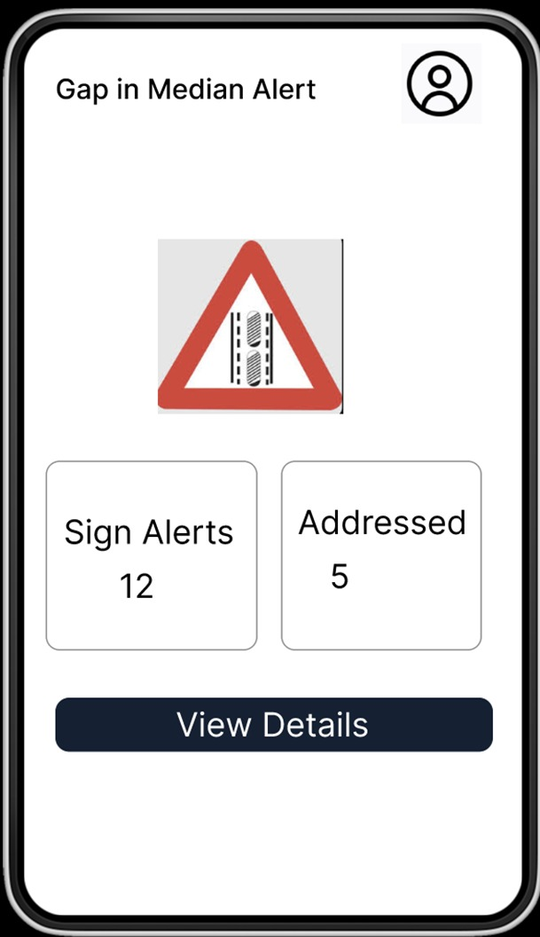
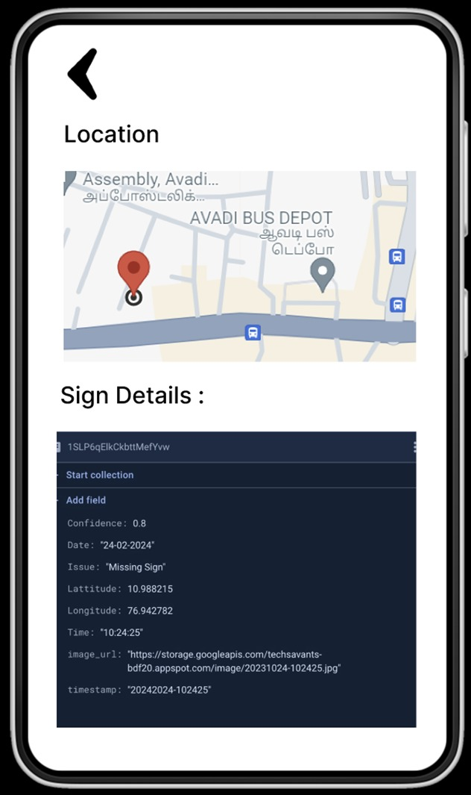

Slide 15
CONCLUSION
In this module, the trained YOLO and DeepSORT model was successfully implemented to detect and track median gaps in real-time. An annotated output video was generated to visually represent the detection results, ensuring clear and interpretable output.This module plays a crucial role in validating the effectiveness of our approach, paving the way for real-world deployment and integration with traffic management and road safety systems.

Slide 16
REFERENCES
"C:\Users\nhars\Downloads\REFERENCES.docx"

